Slide 1

Sustainable Design & Historic Preservation
Sustainably Preserving AND adapting to historic properties

Slide 2
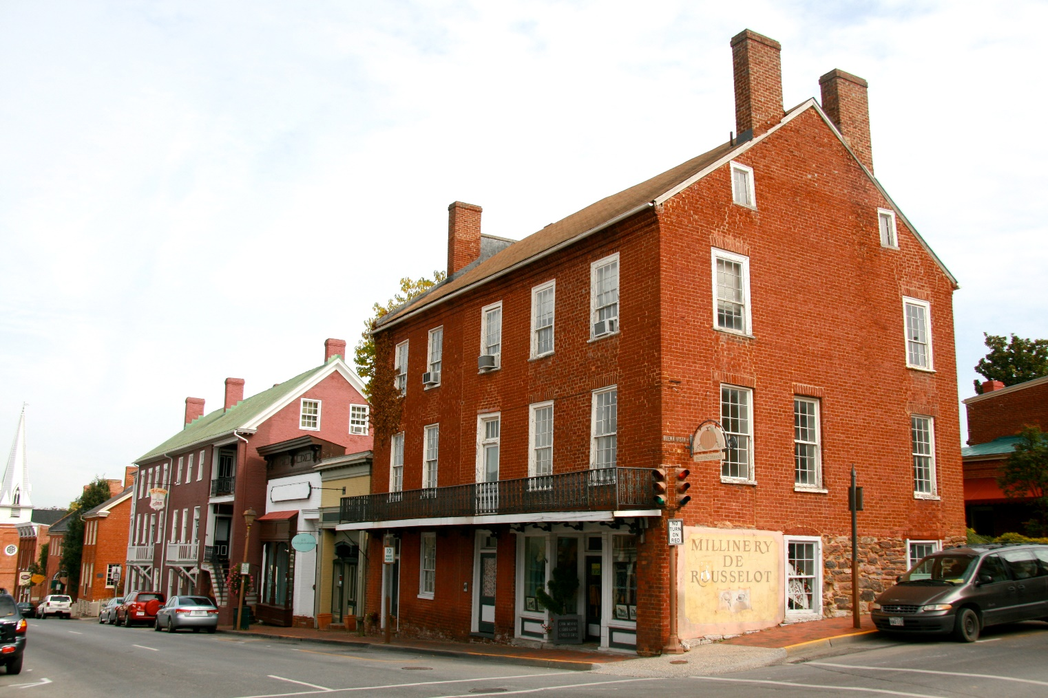
The GREENEST building is the one that already exists…
Notes:
Historic buildings are inherently sustainable. Our challenge is how to adapt historic structures– which were built without modern systems– sensitively, to ensure energy efficiency and sustainable design without impacting the historic character of a property. How to take advantage of the natural, sustainable and energy efficient qualities of historic construction, while sensitively adding to these with modern living features.
This is always the position that we should start with when evaluating historic preservation versus sustainability. The question is, how do we sensitively improve upon the natural sustainable advantages of a historic building, in a way that is mindful of the historic character of a property.

Slide 3
Energy Use of Buildings
In the United States, buildings account for the following:
  37% primary energy use (raw fuels)
  68% all electricity use
  40% non-industrial solid waste (136 million tons of construction and demolition debris per year)
The building and construction industry has the greatest impact of any sector on land use and materials extraction
Refurbishment generates 70% less carbon dioxide than new construction.
It can take 50+ years for new construction to surpass the energy savings of a rehabilitated existing building
  From: Sustainable Preservation: Greening Existing Buildings by Jean Carroon. Hoboken, NJ: John Wiley & Sons, Inc. 2010.

Slide 4
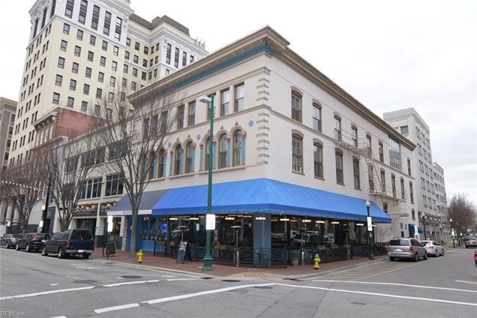
Energy Use- New Construction
There are 300 billion square feet of existing buildings in the United States
Notes:
The best way to be sustainable, then, is to focus on the maintenance and greening of existing buildings.

Slide 5
Embodied Energy
Sum of the energy used to produce the building, as though it were embodied in the building itself
  Labor, transport, growth and production of materials
  Add to the embodied energy of a property through rehabilitation
  “The single most important factor in reducing the impact of embodied energy is to design long-life, durable, and adaptable buildings.”
    Historic properties
Notes:
Historic properties are already in place– they already possess a significant amount of embodied energy. So upfront, they are inherently more sustainable than the construction of a new building, which requires that massive energy investment all over again. And the materials associated with historic buildings are inherently of better quality, more durable and long lasting than many of the products manufactured today. For example, older growth wood is naturally more durable than the faster-grown wood that we use today. Maintenance and restoration of your historic windows will allow them to continue to function for decades more.
A new, green energy-efficient office building that includes as much as 40% recycled materials would still take approximately 65 years to recover the energy lost in demolishing a comparable existing building. https://www.epa.gov/smartgrowth/smart-growth-and-preservation-existing-and-historic-buildings#1

Slide 6
Life Cycle Cost of Historic Buildings
Quality and durability of initial construction, materials, and craftsmanship
Maintained and repaired at a low cost
Reparable- Lacks the built-in obsolescence of many modern features
Notes:
Consider these factors against energy costs. We have to look at environmental impact more holistically than just $.

Slide 7
“Energy consumption should be measured in terms of environmental damage, such as carbon emissions, resource depletion, or habitat destruction…All energy is not equal when it comes to environmental impact….Measuring energy in the form of dollars presumes that environmental damage is related to dollars. It is not.”

Slide 8
Energy-Efficient Design Features
Historic buildings were constructed with inherently sustainable design features
Regional styles adapted to climate and energy use
Notes:
Regional styles- in New England, the focus was on heating. Houses were built with low ceilings, massive walls, and small windows for better heat retention. They often had large central chimneys to radiate heat most efficiently throughout the house. In the hotter south, the focus was on cooling. Houses were built with high ceilings, large windows with shutters and shading porches. Chimneys were located on outer walls—to leach heat to the outside, rather than retain it within the structure—and kitchens were often separate structures to make the house more tolerable in the summertime. Historic occupants built their houses to respect the climate and preserve energy without systems or with few systems.
Reparability- older homes were built to last, not built for obsolescence/replacement. When a portion of a wooden window fails, new wood can be spliced in, broken glass can be replaced, weights and pulleys can be repaired. Individual slates on a slate roof can be replaced. When a vinyl window fails, it can’t be repaired– it fails in whole.

Slide 9
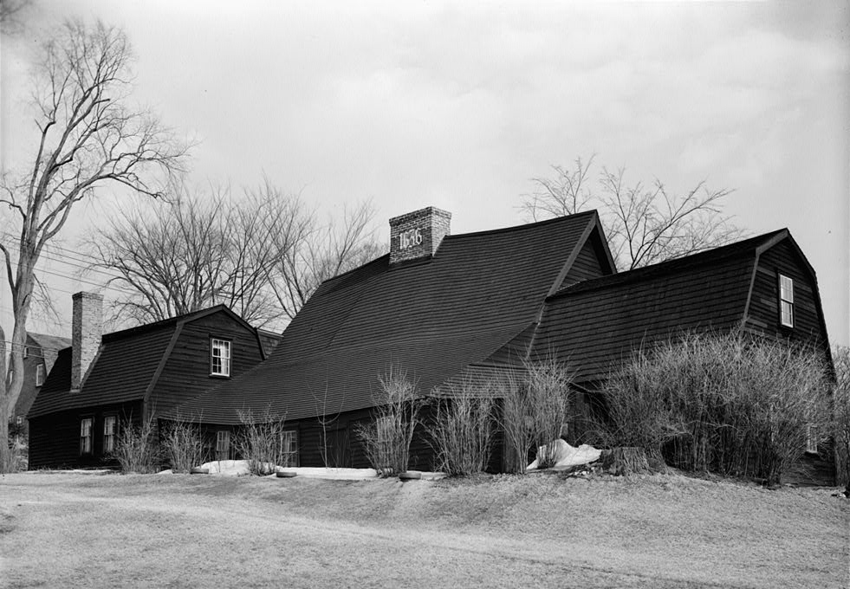
Design Features
Landscaping
  Site
  Berms and trees

Slide 10
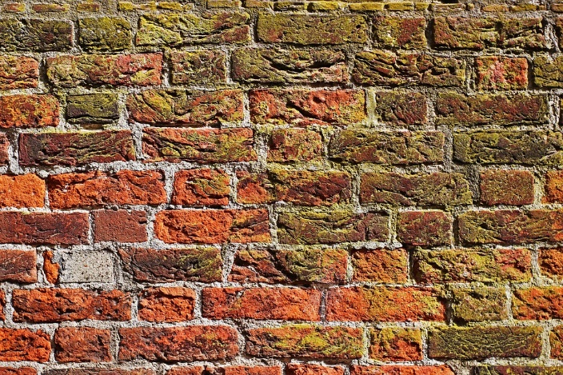
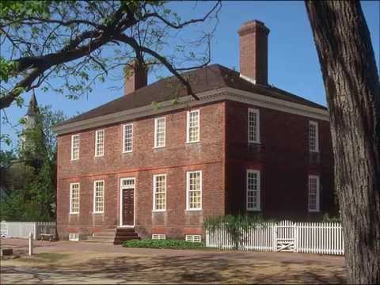
Design Features
Masonry Walls
  Insulative qualities, release of heat
  Stone or brick in the east, adobe in the southwest

Slide 11
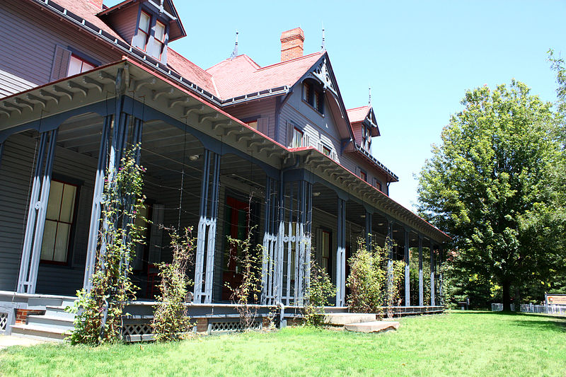
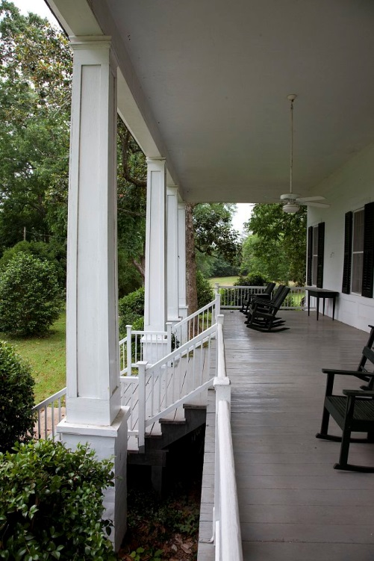
Design Features
Porches
  Shade the high sun in the summer, permit entry of the low winter sun
  Sheltered outdoor
  living
Notes:
Porches– in the south, they also do second floor sleeping porches

Slide 12
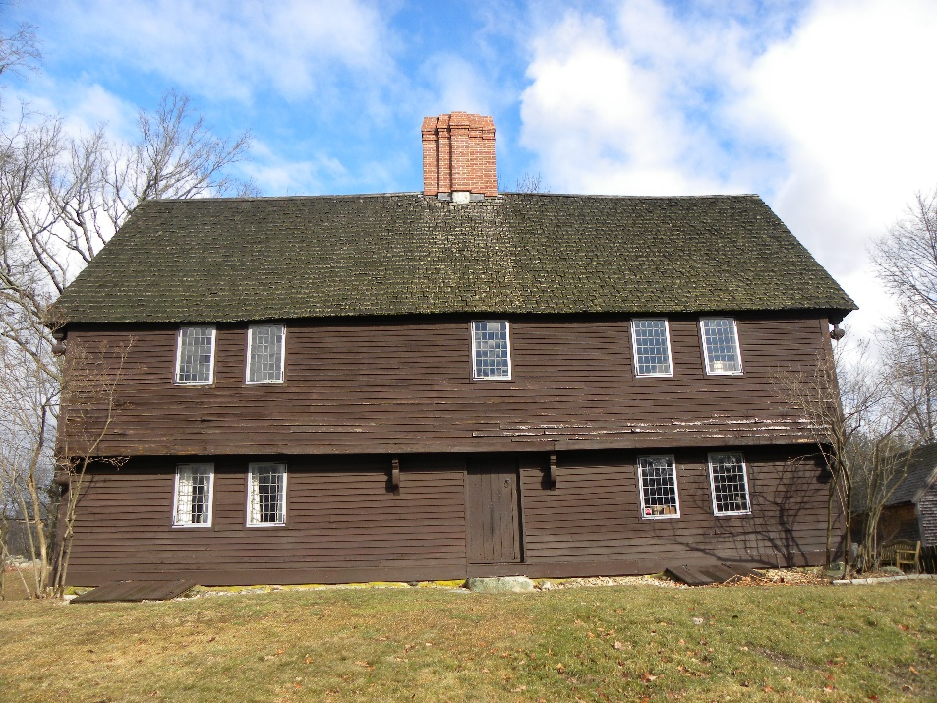
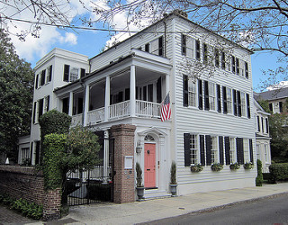
Design Features
Color
  Darker colored structures absorb heat
  Lighter colored structures reflect heat

Slide 13
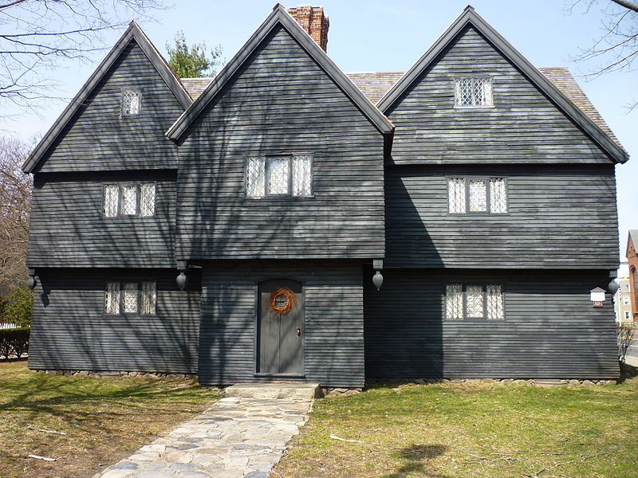
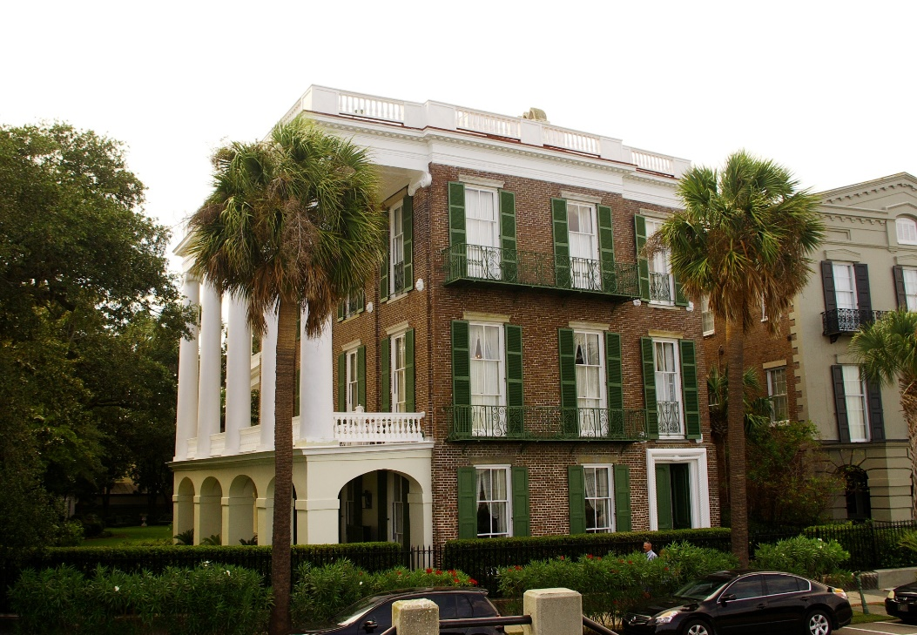
Design Features
Window Size/Location of Openings
  In the south, large, double hung to permit cross-ventilation
  In the north, smaller windows. Fewer located on northern elevations.

Slide 14
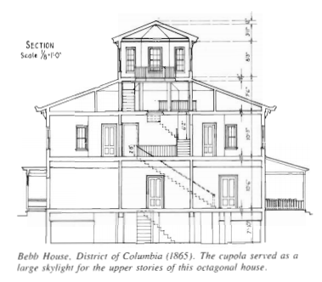
Design Features
Windows- Continued
  Transoms above doors to permit interior cross drafts, interior lighting
  Skylights to vent the house

Slide 15
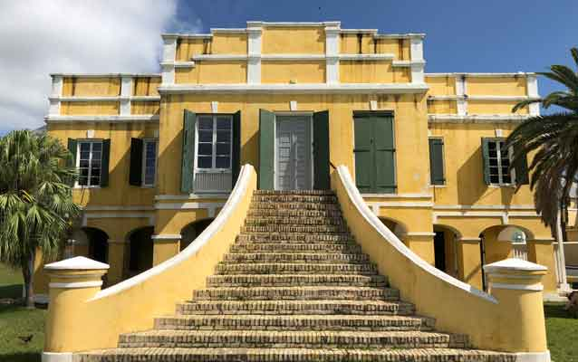
Design Features
Shutters
  Close shutters to shield windows from hot sun and during the winter to keep out the cold.

Slide 16
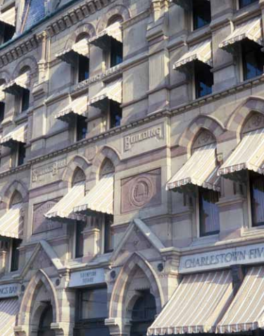
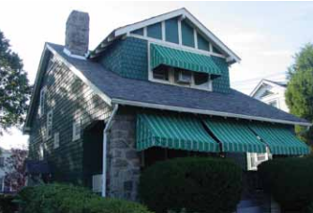
Design Features
Shading devices- Awnings

Slide 17
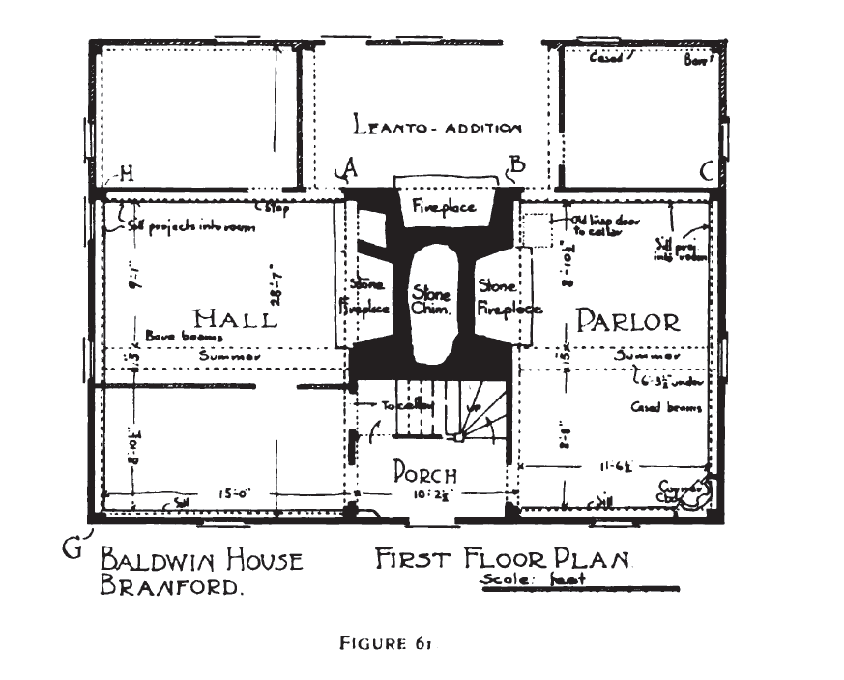
Design Features (continued)
Chimney Size & Placement

Slide 18
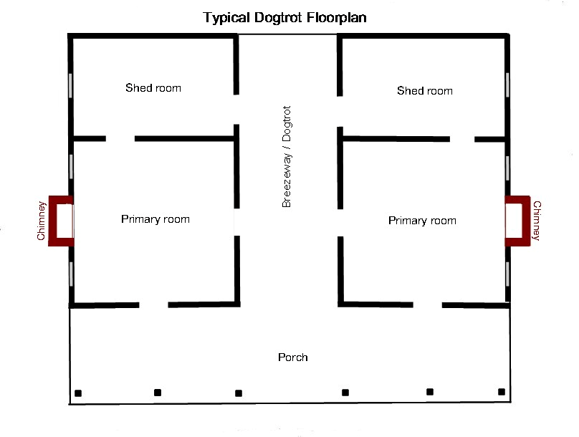
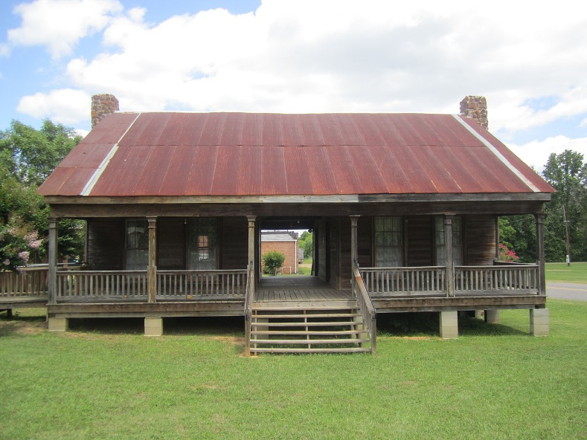

Slide 19
Sustainable Design
Consider the PHYSICAL and VISUAL impact of new work.
Evaluate each structure on a case-by-case basis.

Slide 20
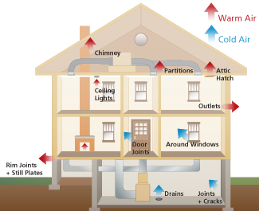
Energy Efficiency
Energy Audit
  Identify deficiencies in the building envelope or mechanical systems
  Measures the R-value
  (resistance to heat loss) of
  the building
  Identifies areas of air
  infiltration
Notes:
First thing you need to do is learn about your particular building.
An energy audit evaluates the building’s current thermal performance and identifies any deficiencies in the building envelope or mechanical systems. Measures the r-value of the various component of the building envelope, including walls, ceilings, floors, doors windows, and skylights. The R-value measures resistance to thermal transfer (heat loss); the higher the number the better resistance is to heat loss. The audit also includes inspection of the building envelope to identify areas of air infiltration.

Slide 21
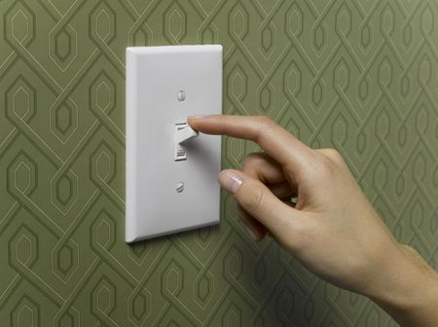
Energy Efficiency
Weatherization
  Seek to improve on what you already have.
  Keep interventions physically/visually minimal
Modify user behavior
Notes:
Every applicant should consider the most minimal interventions at first to improve their energy efficiency. Weatherization (caulking, weatherstripping of doors and windows) and modifying user behavior (turning off the lights when you leave a room, opening windows to take advantage of the breeze on a spring day instead of immediately turning on the air conditioning).

Slide 22
Windows
Not the greatest source of energy loss in a building
Repair and upgrade windows and doors
  Caulk/weatherize to limit air infiltration
Add storm windows
  Adding a storm window achieves a similar thermal performance to a new vinyl window
  Embodied energy
  Historic, durable materials (vs. vinyl)
Notes:
Studies have shown that windows only account for 10% of energy loss in a structure, with roof and exterior walls serving as the main sources of energy leakage. Yet windows are often the first items targeted for replacement.

Slide 23
Windows
Interior & Exterior storms– both are acceptable
  Storms should not harm the historic fabric (#2, #10)
  Should match the size, shape, and configuration of the existing windows
  Should be as low-profile as possible, with a meeting rail that crosses in the same location as the historic meeting rail (#2)
Use internal curtains, blinds, shutters

Slide 24
Windows
Retrofitting Windows
  Adding tracks
  Insulating the weight pocket
Notes:
Historic windows can be retrofitted, weatherized, and repaired multiple times. When modern windows fail– and they fail because of built-in obsolescence– they will need to be replaced. Historic windows are more sustainable.

Slide 25
Window Replacement
Replacement
  Go with a window that mimics the configuration and appearance of the historic windows (#2)
  Materials (#6)
    Wood
    Aluminum clad wood
    Vinyl
    Aluminum vs. Steel
Notes:
What about in a case where the windows are deteriorated beyond repair, or are missing?
What is permissible in your local guidelines is what is acceptable.
Speaking from a tax credit perspective, wood is obviously the most direct correlation to Standard #6. A deteriorated wood window should be replaced with like materials– wood. If a wood window is deteriorated beyond repair in tax credit land, we require that they go back with wood. The same is true for if a window is missing, but there are historic wood examples remaining in other openings that can be replicated. You know what was there—replicate it. If windows are missing entirely, throughout the structure, then I will approve a clad window. Basically, we are trying to avoid a direct comparison between the historic wood window and the possibly bulkier clad window. We do not, in the tax credit program, ever approve vinyl. We also don’t approve composite windows in general.
Generally, we require where windows are missing entirely, and the historic window configuration is unknown, to go back with a 1/1 window. That is the simplest contemporary and compatible window style– no guesswork. BUT, again, it depends on a case-by-case basis. I have asked for multi-light on structures where it’s clear that multi-light was the historic type. Better to match the character of the building then.
Aluminum versus steel– I have approved replacing steel windows with aluminum windows before, although the dimensions are slightly different.

Slide 26
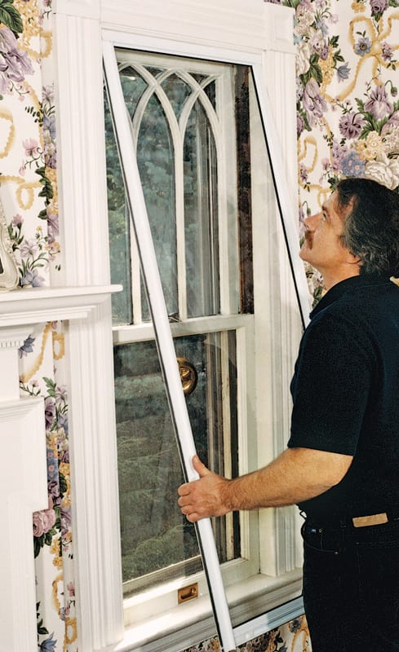
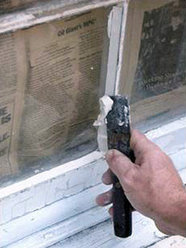
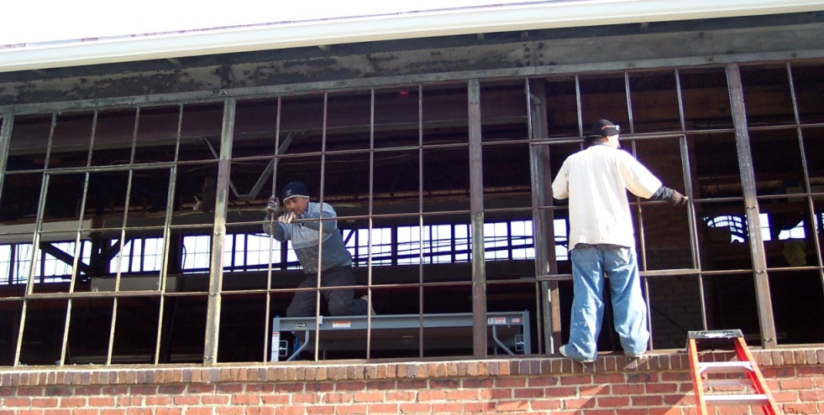

Slide 27
Insulation
Brick/Masonry Walls- don’t insulate
  Natural insulative properties
  Volume/spatial characteristics
  Moisture
Frame- Acceptable where not invasive
  Where plaster is down, where exterior cladding is deteriorated and needs replacement
  Vapor barrier
Spray Foam- not reversible, not approved
Notes:
Brick/Masonry Walls- These have natural insulative qualities. They are thicker, the brick also gathers heat during the day and releases it during the night. This is good because it maintains a more constant, even-keeled temperature. In northern climates, it allows the structure be heated at night (as the heat stored in the brick naturally releases in the cooler temperature). In southern climates, the same thing happens, which is good because it means that the bricks are not releasing heat during the hottest part of the day, but at night when it is cooler and less noticeable.
Brick—especially older, more porous brick– naturally has water move through it. There are pores, or capillaries, in the brick that draw water from the air and the atmosphere. The water passes through the brick and evaporates in the interior of the building. You can’t stop this process– it’s a natural way that the brick behaves. Insulating on the interior of the brick can cause moisture problems, as the water passes into the insulation and gets trapped in the wall cavity (created by studs). Even if you add a vapor barrier, or spray foam the brick, you’ve created a problem– now the brick can’t breathe, and when there is high humidity on the exterior of the brick walls, and water moves into the brick (moving from an area of high humidity to less humidity, moisture transfer)– it gets trapped in the brick and cannot evaporate. This can lead to long-term deterioration of the walls as the water pressure within the historic brick builds—and eases—and builds over time.
Also, in historic properties plaster was often applied directly to the brick. Plaster is more breathable than modern materials such as drywall. In order to insulate brick walls, you would need to build out a cavity for the insulation– incorporating new wall studs. At a minimum, you are looking at a depth of probably 4”. This impacts character-defining historic features such as woodwork– which would either need to be removed and reapplied (incredibly invasive) or lose its reveal/be buried. It also impacts the historic volume and spatial characteristics of a room. Think about the window depths that will be created– tunnel-like– to accommodate the new insulation. It’s really not necessary for historic masonry walls and is damaging to the historic interior character, as well as in some cases the historic material (brick) itself.
Spray foam is a Standard #10 violation. It adheres to the historic material, is not reversible, and can cause issues with breathability of the historic materials. You want some air flow in your hose.

Slide 28
Insulation
Best to limit insulation to attics/basements/crawl spaces, where it can be added without damaging significant historic material
Alternatives
  Insulate your attic, basement, and crawl space
  Wrap your pipes to protect them
  Rigid board is the preferred treatment
  Do not add insulation to cavities prone to water infiltration
Notes:
Rigid board is the preferred treatment, although so long as its not spray foam, I usually don’t ask questions.

Slide 29
New Systems
Design your systems sensitively, to avoid a significant visual impact
Pair new systems with the natural, energy-efficient components of the historic structure
  Don’t install a huge HVAC system when one is not necessary to cool your property

Slide 30
New Systems
Exterior HVAC components should be sensitively installed (not in highly visible locations) and screened as necessary to minimize visual impact
Rooftop components should not be visible from the ground
The smallest components possible—for the interior and the exterior—should always be used.
Notes:
Generally advise against screening rooftop components, because that tends to make them even more visible. If they are visible to begin with, a screen is not going to help.
Can be difficult to locate rooftop HVAC on small-scale structures. Should be set back from the edges of the building.

Slide 31
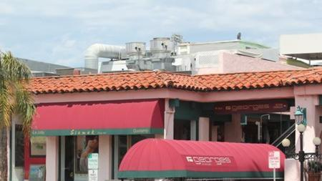
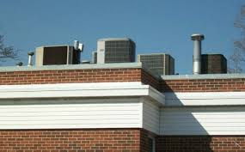

Slide 32
Solar Panels
May be installed in non-visible, unobtrusive locations on historic buildings
May be minimally visible on new additions
If free standing, should be located in unobtrusive locations on the site (not on primary elevations)

Slide 33
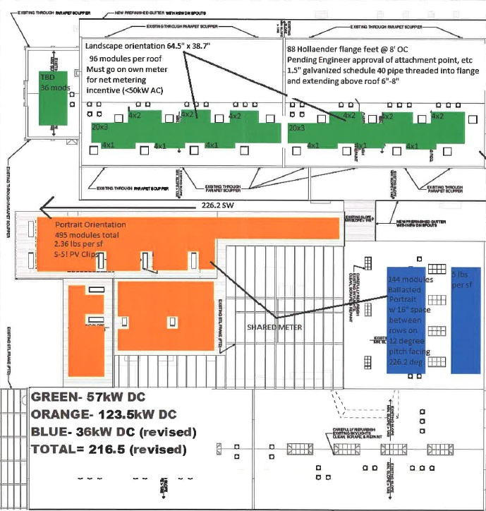
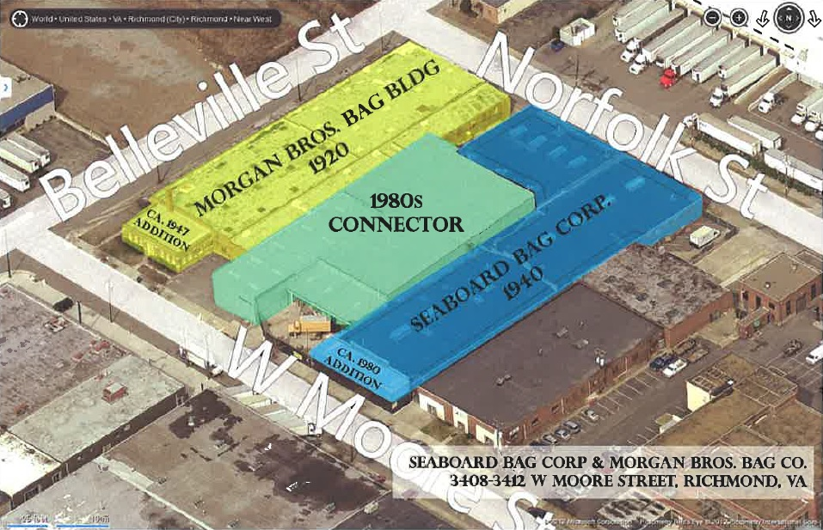
The Seaboard Bag Corporation
Notes:
This was the rehabilitation of a historic manufacturing complex in Richmond that was converted to apartments in 2015. As part of the adaptive reuse, skylights were installed on the flat roofs of the 1920s, 1940s, and 1980s buildings.

Slide 34
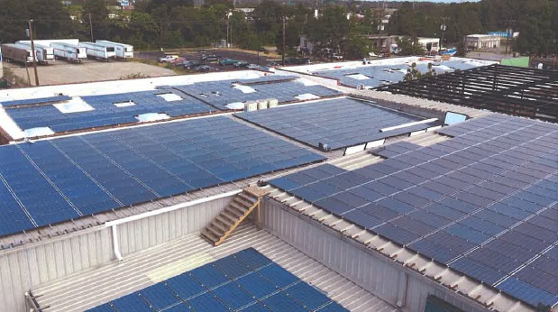
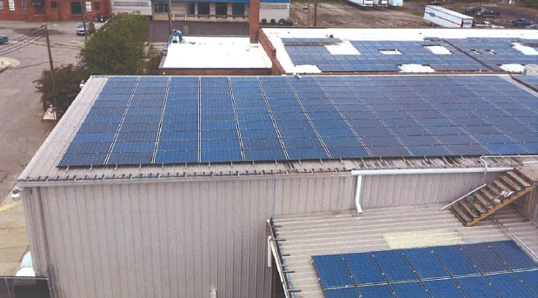
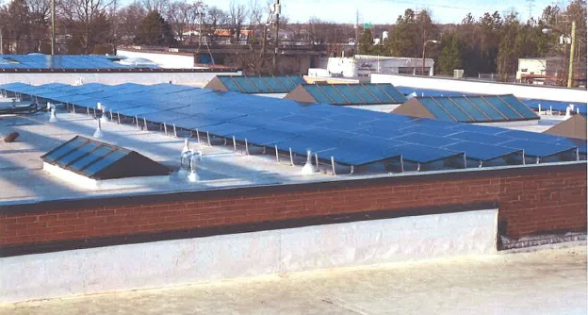
Seaboard Bag Corporation

Slide 35
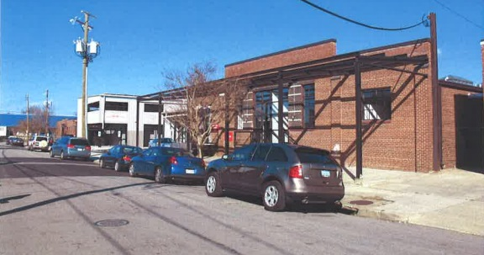
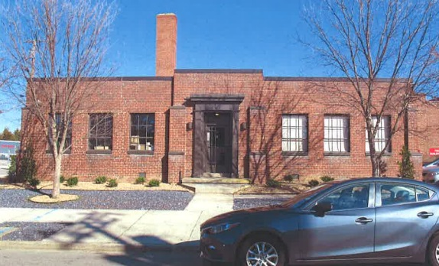
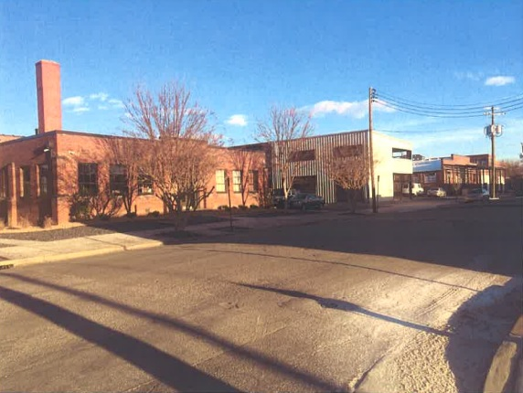
Seaboard Bag Corporation

Slide 36
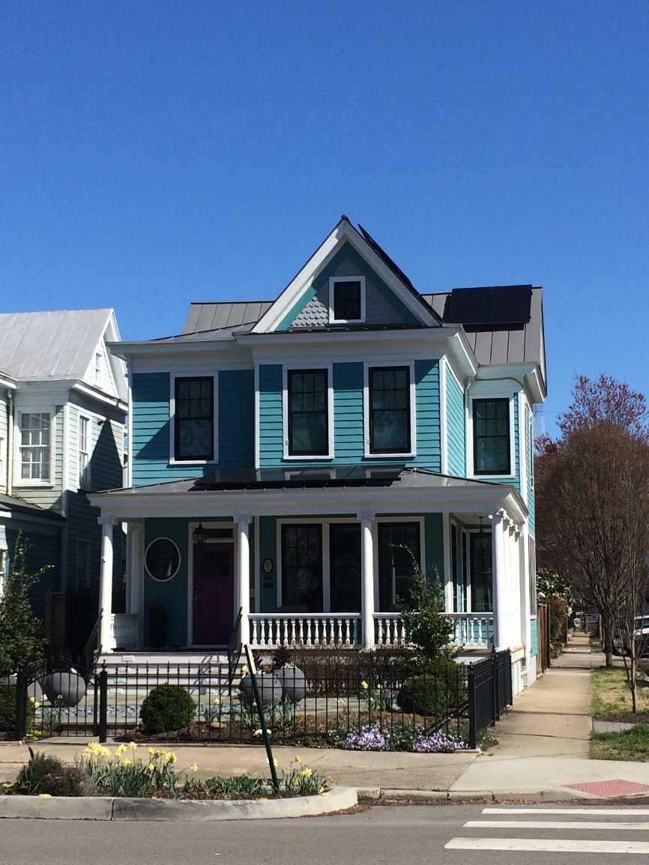
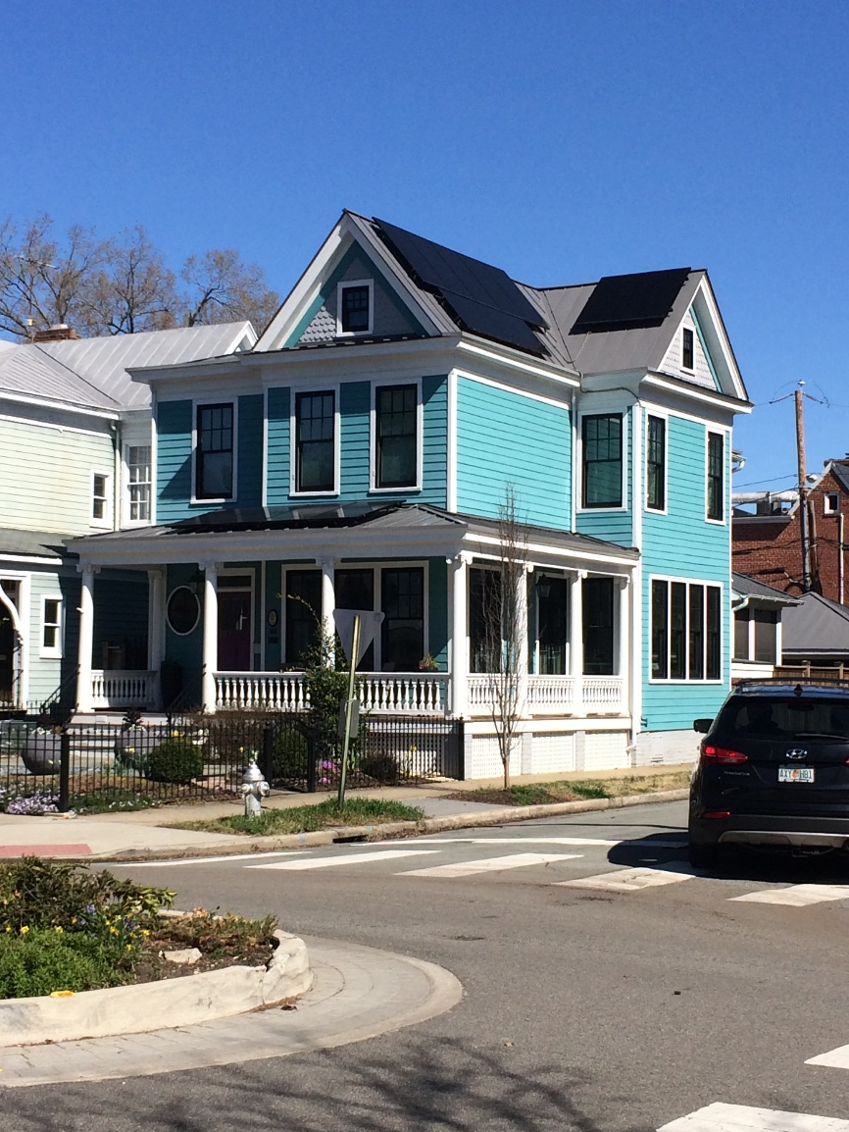
Richmond Dwelling

Slide 37
Green Roofs
A layer of vegetation planted over a waterproofing system that is installed on top of a flat or slightly-sloped roof.
Benefits:
  Stormwater Management
  Insulates the building
  Better mechanical performance
  Extends the life of the roof by protecting the roofing materials from the sun (can double life expectancy)
  Provides rooftop amenities
Notes:
Stormwater Management: Green roofs absorb rainwater, keeping it from flowing through the streets
Better mechanical performance

Slide 38
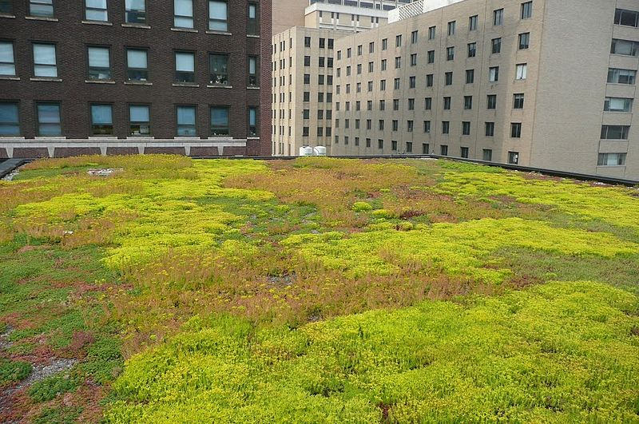
Green Roofs
Consider:
  Visual impact
  Physical impact (weight)
Notes:
Think about height and setback– same thing as a rooftop deck or rooftop addition. You want to make sure that you consider auxiliary items such as railings– will guard rails be needed? Will these be visible? As well as amenities– what about things like umbrellas if the rooftop will be accessible?

Slide 39
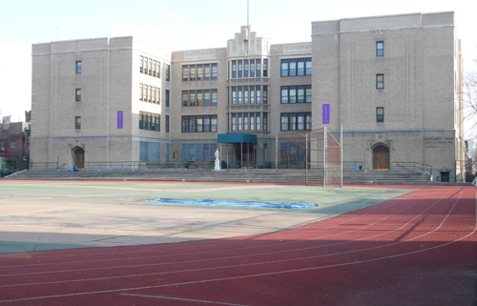
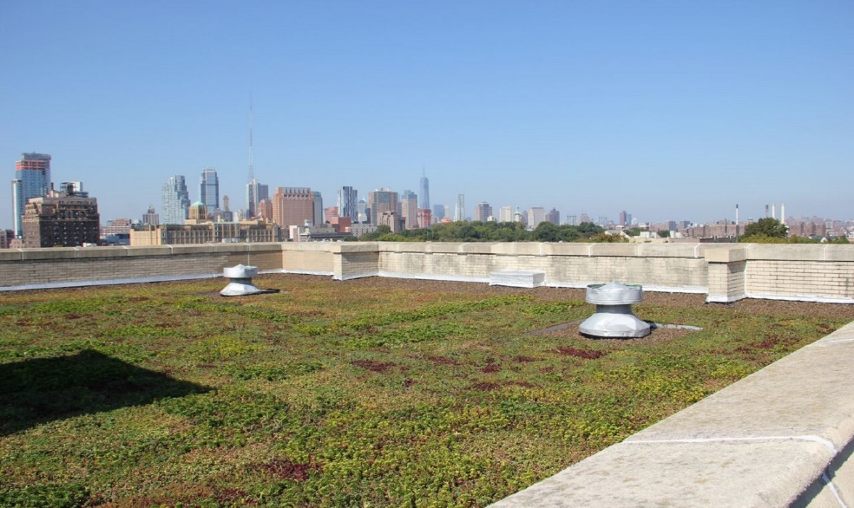

Slide 40
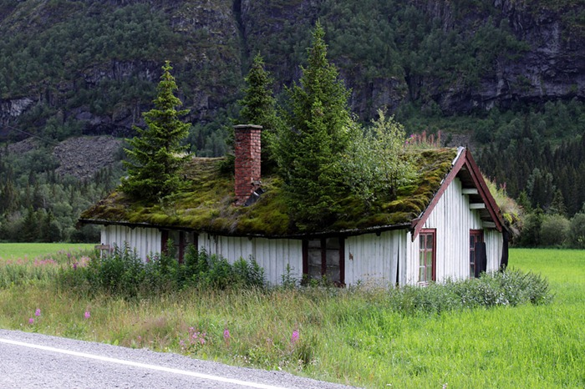

Slide 41
Geothermal
Uses the constant temperature underground to heat and cool a property
Higher upfront costs, but lower heating/cooling costs
Fluid running through pipes installed underground; circulates throughout a traditional duct system or under radiant floors
Construction of wells
  Archaeology
  Significant landscapes
Notes:
The temperature underground is cooler in the summer and warmer in the winter.
A homeowner can recoup their initial costs in energy savings costs over a period of 5-10 years.
Little visual impact, but does require significant ground disturbance, disturbance of landscapes

Slide 42
CLG Role
A historic commission’s primary goal is the protection of individual buildings and neighborhoods
As sustainability continues to influence rehabilitation requests/design features, it is important to be able to address/respond to this topic
Educate the public on appropriate and inappropriate approaches to sustainability within historic districts
Build sustainability into historic district guidelines
Notes:
While an applicant’s desire to achieve sustainability and consider their environmental impact is laudable, the historic commission’s primary goal is the protection of individual buildings and neighborhoods. The preservation of historic character should continue to trump sustainability when considering requets.s.
Proactive approach- building sustainability into the guidelines for a historic district, so that there is guidance for homeowners and the historic commissions
Reactive approach- enforcement when these guidelines are violated and historic character of a building and/or neighborhood is impacted.

Slide 43
Incorporating Sustainability into Guidelines
Emphasize the inherent sustainability of historic structures
  Architectural features
  Embodied Energy
  Reparability
Highlight non-intrusive ways of achieving better energy efficiency
  Repairs and upgrades
Address specific topics that are likely to come up
  Rooftop mechanical units, solar panels, energy efficiency
Notes:
The role of the architectural review board is to preserve historic character. Sustainability can be a part of this– but there may be a building where solar panels just can’t be installed without a significant visual impact. Too often, more extreme requests are made of historic commissions– such as, can we replace all of our windows?– when more simple fixes (such as caulking the windows, adding storm windows, insulating the roof to address the real source of energy loss)– have not been considered by the homeowner.
“Historic commissions are frequently criticized for not accepting relatively “green” materials, replacement windows, and visible statements of sustainable intent such as photovoltaic panels, but the commissions are charged with protection of individual buildings and neighborhoods.”
Highlight non-intrusive ways-
Caulking your windows
Adding storm windows
Adding insulation
Landscaping- adding trees
Addressing specific topics- having a policy is the best way of dealing with this. And this can be how your ARB and your CLG choose to address these topics– what you intend to allow in terms of what you believe is acceptable. Tax credits, we are going to have a stricter interpretation of what is allowed, because it is an incentive program. People are participating and asking the State to be a 25% investor in their project, so they have to make some concessions.

Slide 44
Incorporating Sustainability into Guidelines
Incorporate explicit language about sustainability
Case-by-case basis
  The Standards
Notes:
Warrenton- does not have an explicit section on sustainability, but it does address a number of sustainable issues– adding solar panels, weather-stripping windows, etc.
Leesburg- No explicit section on sustainability, but it does address energy efficiency with regards to windows and awnings, emphasize weatherization techniques as the first step. That’s a plus.

Slide 45
IN SUM
Preservation is an inherently sustainable practice
Focus on the preservation of a property’s historic character-defining features and historic energy-efficient features. Sensitively add to these with modern technologies where appropriate.
Evaluate the physical and visual impact of all proposed interventions and technologies
Focus on reversibility to preserve the historic structure in anticipation of new and better technologies

Slide 46
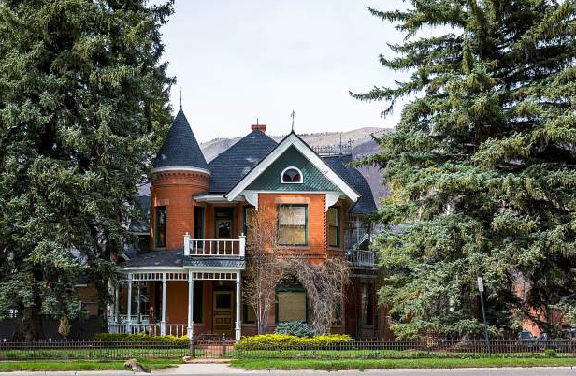
Case Study

Slide 47
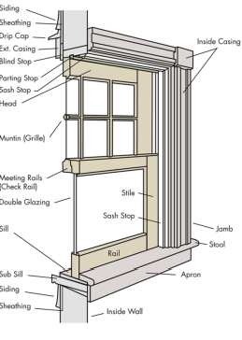
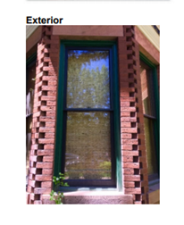
Case Study
1891 Dwelling
Replacement of window glass with thermopane glass for energy efficiency

Slide 48
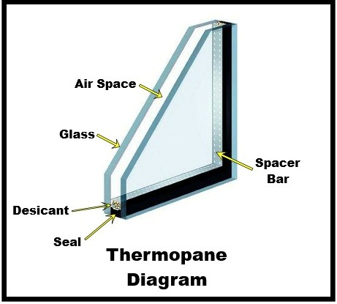
Case Study
Thermopane units are built with two pieces of glass on either side of a breather strip/spacer. According to the contractor this is preferable to a storm window.
The use of thermopane would definitely
improve energy efficiency
On some windows in the house, replacing
the single glass panels with new ¾” or ½”
thick thermal insulated glass will require
part of the windows sash to be removed
to accept new glass. The contractor will
rout out a piece of the wood window to
fit the insulated glass.

Slide 49
Case Study
Does the current plan adhere to the Secretary of Interior’s Standards for Rehabilitation? Why or Why not? Which Standards apply?
Are there other alternatives to achieve energy efficiency where the windows are concerned?

Slide 50
Case Study
Does the current plan adhere to the Secretary of Interior’s Standards for Rehabilitation? Why or Why not? Which Standards apply?
  #7 : Damaging physical treatments
  #10: Reversibility
Are there other alternatives to achieve energy efficiency where the windows are concerned?
  Low-profile storm windows
  Insulate the roof and the basement
Notes:
If the windows were deteriorated beyond repair, we could consider replacements with thermopane– but that does not seem to be the case here.

Slide 51
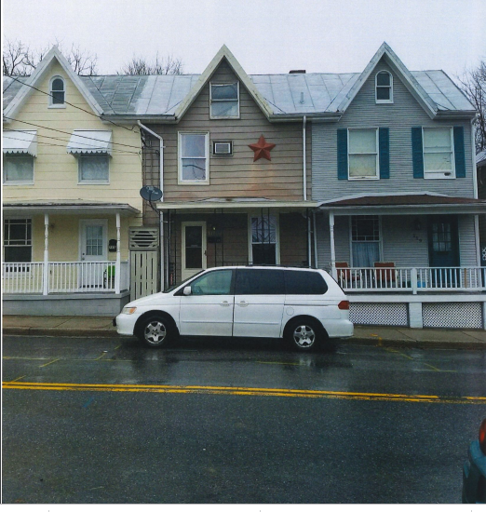
Case Study
The applicant proposes to install eight solar panels and two solar hot water collectors on the existing shed roof capping the
ca. 1910 dwelling.

Slide 52
Case Study
Solar panels will lay flat against the sloped roof pitch
Owners say the panels will not be visible from the street
There is a public alley behind the property; it is 185 feet from the rear elevation of the house

Slide 53
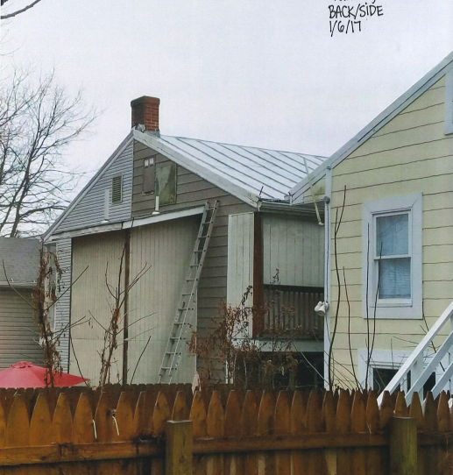
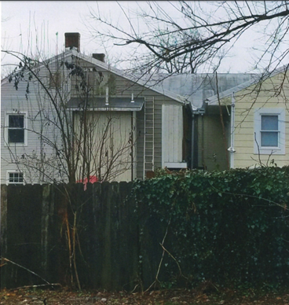

Slide 54
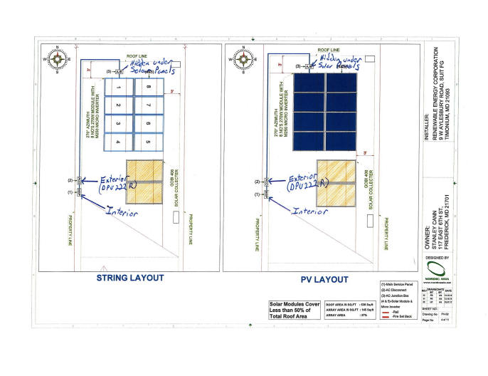
Case Study

Slide 55
Case Study
Does the current plan adhere to the Secretary of Interior’s Standards for Rehabilitation? Why or Why not? Which Standards apply?
In this case does the public alley count as a public viewshed?
Do you approve this proposal? Why or why not? Do you have any suggestions for the applicant?
Notes:
If the windows were deteriorated beyond repair, we could consider replacements with thermopane– but that does not seem to be the case here.

Slide 56
Case Study
Does the current plan adhere to the Secretary of Interior’s Standards for Rehabilitation? Why or Why not? Which Standards apply?
  #2: Preserving the historic character of the property
In this case does the public alley count as a public viewshed?
  Perhaps- but since the view is from the rear, this is not a high priority. This is the best possible roof location for these units.
Do you approve this proposal? Why or why not? Do you have any suggestions for the applicant?
  Tax credit approval
  Solar panels are on the rear, will be minimally visible from an alley
  Best possible location
  Suggestions: Mock them up first so that we can understand the visibility
Notes:
If the windows were deteriorated beyond repair, we could consider replacements with thermopane– but that does not seem to be the case here.

Slide 57
Additional Resources
https://www.nps.gov/tps/sustainability.htm
Illustrated Guidelines on Sustainability: https://www.nps.gov/tps/standards/rehabilitation/sustainability-guidelines.pdf
Energy Conserving Features Inherent in Older Homes: https://www.nps.gov/tps/sustainability/greendocs/conservation-features-older-homes.pdf

Slide 58
For More Information
Federal Program
www.NPS.gov/TPS
State Program
www.dhr.virginia.gov/tax_
credits/tax_credit.htm

Slide 59
DHR Program Contacts
Elizabeth Tune – Program Manager
Elizabeth.Tune@dhr.virginia.gov
804-482-6093
Chris Novelli – Tax Credit Specialist
Chris.Novelli@dhr.virginia.gov
804-482-6097
Carolyn Zemanian– Tax Credit Reviewer
Carolyn.Zemanian@dhr.virginia.gov
804-482-6095

