Slide 1
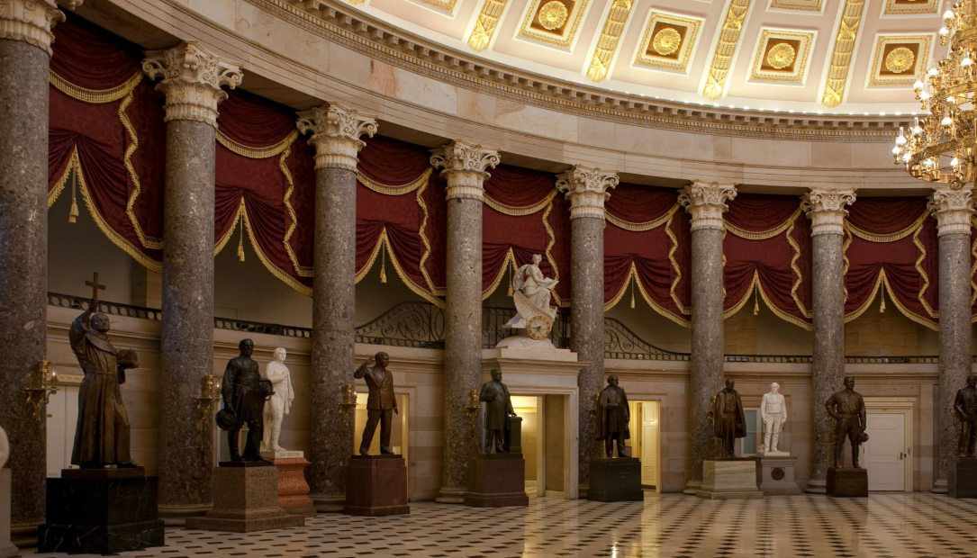

MEETING of the COMMISSION for HISTORICAL STATUES in the UNITED STATES CAPITOL
10:30 a.m. October 8, 2020
Thank you for joining us, the meeting of the Commission will begin momentarily
We are concerned about your health, and we are committed to do all we can to reduce the risk and spread of novel coronavirus. Governor Ralph Northam declared a state of emergency in Virginia on Thursday, March 12 in response to COVID-19. In light of this action, the meeting of the Commission is being conducted using electronic communications in accord with Item 4-0.01.g. of Chapter 1283 (2020 Acts of Assembly),
as the COVID-19 emergency makes it impracticable or unsafe
to assemble in a single location.
The purpose of the meeting is to discuss or transact the business statutorily required or necessary to continue operation of the Commission and the discharge of its lawful purposes, duties,
and responsibilities.
All Commission members and staff will be participating remotely.
In the event there is a disruption in the broadcast of the meeting,
please call (804) 482-6446.
Commission for Historical Statues
in the United States Capitol

Slide 2
MEETING of the COMMISSION for HISTORICAL STATUES in the UNITED STATES CAPITOL
10:30 a.m. October 8, 2020
AGENDA
Call to Order
Roll Call of Attendees
Approval of Meeting Agenda
Approval of August 7, 2020 Meeting Minutes
Status of Request to Remove Robert E. Lee Statue
Public Comment:
Summary of Written Public Comment Received Since August 7
Oral Public Comment
Next Steps:
Proposed Timeline
Proposed Budget
Proposed Process for Selecting Subject of Replacement Statue
Adjourn
Commission for Historical Statues
in the United States Capitol

Slide 3
MEETING of the COMMISSION for HISTORICAL STATUES in the UNITED STATES CAPITOL
10:30 a.m. October 8, 2020
AGENDA
Call to Order
Roll Call of Attendees
Approval of Meeting Agenda
Approval of August 7, 2020 Meeting Minutes
Status of Request to Remove Robert E. Lee Statue
Public Comment:
Summary of Written Public Comment Received Since August 7
Oral Public Comment
Next Steps :
Proposed Timeline
Proposed Budget
Proposed Process for Selecting Subject of Replacement Statue
Adjourn
Commission for Historical Statues
in the United States Capitol

Slide 4
MEETING of the COMMISSION for HISTORICAL STATUES in the UNITED STATES CAPITOL
10:30 a.m. October 8, 2020
AGENDA
Call to Order
Roll Call of Attendees
Approval of Meeting Agenda
Approval of August 7, 2020 Meeting Minutes
Status of Request to Remove Robert E. Lee Statue
Public Comment:
Summary of Written Public Comment Received Since August 7
Oral Public Comment
Next Steps :
Proposed Timeline
Proposed Budget
Proposed Process for Selecting Subject of Replacement Statue
Adjourn
Commission for Historical Statues
in the United States Capitol

Slide 5
MEETING of the COMMISSION for HISTORICAL STATUES in the UNITED STATES CAPITOL
10:30 a.m. October 8, 2020
AGENDA
Call to Order
Roll Call of Attendees
Approval of Meeting Agenda
Approval of August 7, 2020 Meeting Minutes
Status of Request to Remove Robert E. Lee Statue
Public Comment:
Summary of Written Public Comment Received Since August 7
Oral Public Comment
Next Steps :
Proposed Timeline
Proposed Budget
Proposed Process for Selecting Subject of Replacement Statue
Adjourn
Commission for Historical Statues
in the United States Capitol

Slide 6
MEETING of the COMMISSION for HISTORICAL STATUES in the UNITED STATES CAPITOL
10:30 a.m. October 8, 2020
AGENDA
Call to Order
Roll Call of Attendees
Approval of Meeting Agenda
Approval of August 7, 2020 Meeting Minutes
Status of Request to Remove Robert E. Lee Statue
Public Comment:
Summary of Written Public Comment Received Since August 7
Oral Public Comment
Next Steps :
Proposed Timeline
Proposed Budget
Proposed Process for Selecting Subject of Replacement Statue
Adjourn
Commission for Historical Statues
in the United States Capitol

Slide 7
MEETING of the COMMISSION for HISTORICAL STATUES in the UNITED STATES CAPITOL
10:30 a.m. October 8, 2020
Status of Request to Remove Robert E. Lee Statue
The interim report approved on August 7 was submitted to the General Assembly
As requested by the Commission, a letter was sent to VMHC requesting their acceptance of the Lee statue
VMHC agreed to accept Lee statue
Langan received verbal confirmation that the Joint Committee on the Library has approved Governor Northam’s request and that written approval is forthcoming
Langan received clarification from the Architect of the US Capitol re: removal process
Commission for Historical Statues
in the United States Capitol

Slide 8
MEETING of the COMMISSION for HISTORICAL STATUES in the UNITED STATES CAPITOL
10:30 a.m. October 8, 2020
AGENDA
Call to Order
Roll Call of Attendees
Approval of Meeting Agenda
Approval of August 7, 2020 Meeting Minutes
Status of Request to Remove Robert E. Lee Statue
Public Comment:
Summary of Written Public Comment Received Since August 7
Oral Public Comment
Next Steps :
Proposed Timeline
Proposed Budget
Proposed Process for Selecting Subject of Replacement Statue
Adjourn
Commission for Historical Statues
in the United States Capitol

Slide 9
Summary of Written Public Comment Received Since August 7
Reconsider removal of Robert E. Lee statue
Remove, not replace
Specific suggestion for replacement person
Commission for Historical Statues
in the United States Capitol

Slide 10
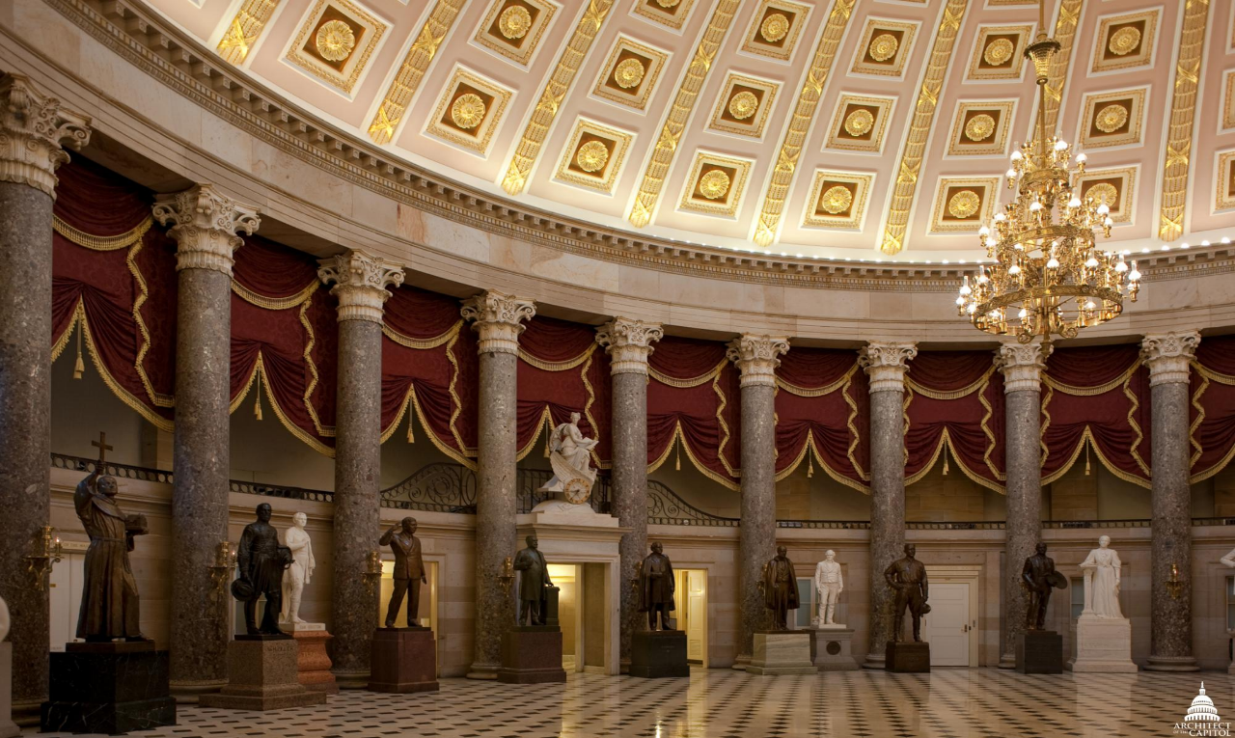
Oral Public Comment
Commission for Historical Statues
in the United States Capitol

Slide 11
MEETING of the COMMISSION for HISTORICAL STATUES in the UNITED STATES CAPITOL
10:30 a.m. October 8, 2020
AGENDA
Call to Order
Roll Call of Attendees
Approval of Meeting Agenda
Approval of August 7, 2020 Meeting Minutes
Status of Request to Remove Robert E. Lee Statue
Public Comment:
Summary of Written Public Comment Received Since August 7
Oral Public Comment
Next Steps :
Proposed Timeline
Proposed Budget
Proposed Process for Selecting Subject of Replacement Statue
Adjourn
Commission for Historical Statues
in the United States Capitol

Slide 12
MEETING of the COMMISSION for HISTORICAL STATUES in the UNITED STATES CAPITOL
10:30 a.m. October 8, 2020
Proposed Timeline
October 8: Commission agrees on selection process & criteria
October 16: Initiate 30 day public comment period
November TBD: Commission to hold public hearing
December TBD: Commission to meet to select the subject of the replacement statue
TBD: Remove Robert E. Lee/transport to Richmond
January/Feb: Seek General Assembly approval of person selected
to replace Lee
Feb.: Send approved replacement statue subject to the Joint Committee on the Library for approval
Mar./April: Develop and approve plan for artist selection process
Commission for Historical Statues
in the United States Capitol

Slide 13
MEETING of the COMMISSION for HISTORICAL STATUES in the UNITED STATES CAPITOL
10:30 a.m. October 8, 2020
Proposed Budget
Artist Selection Process $27,000
Artist Work Process $350,000
Rigging $42,000
Transport $5,000
Unveiling $75,000
ESTIMATED TOTAL $498,500
Commission for Historical Statues
in the United States Capitol

Slide 14
MEETING of the COMMISSION for HISTORICAL STATUES in the UNITED STATES CAPITOL
10:30 a.m. October 8, 2020
Proposed Process for Selecting Subject of Replacement Statue
Over the next two months, the Commission will:
agree on the values and attributes that the new subject should represent
invite the public to submit suggested persons for consideration
hold a public hearing to solicit public comment on the replacement subject
compile and share with the public the list of suggested subjects
research the suggested persons to determine the values and attributes they represent
narrow the list to five possible subjects
hold a meeting to select the subject of the replacement statue
Commission for Historical Statues
in the United States Capitol

Slide 15
MEETING of the COMMISSION for HISTORICAL STATUES in the UNITED STATES CAPITOL
10:30 a.m. October 8, 2020
Proposed Selection Criteria:
Architect of the US Capitol Selection Criteria:
The replacement statue must:
    be a deceased person
    have been a citizen of the United States
    be illustrious for historic renown or for distinguished civic or military service
    represent only one individual
Commission for Historical Statues
in the United States Capitol

Slide 16
MEETING of the COMMISSION for HISTORICAL STATUES in the UNITED STATES CAPITOL
10:30 a.m. October 8, 2020
Proposed Selection Criteria:
Draft Commission Values and Attributes:
association with significant events that changed the course of history
association with significant ideals, writings, and/or intellectual thought
exemplification of valor, patriotism, bravery
the subject’s primary historical significance should be tied to Virginia directly, or they should have spent the majority of their life, in the state
the person should not be in conflict with current prevailing values
Commission for Historical Statues
in the United States Capitol

Slide 17
MEETING of the COMMISSION for HISTORICAL STATUES in the UNITED STATES CAPITOL
10:30 a.m. October 8, 2020
AGENDA
Call to Order
Roll Call of Attendees
Approval of Meeting Agenda
Approval of August 7, 2020 Meeting Minutes
Status of Request to Remove Robert E. Lee Statue
Public Comment:
Summary of Written Public Comment Received Since August 7
Oral Public Comment
Next Steps :
Proposed Timeline
Proposed Budget
Proposed Process for Selecting Subject of Replacement Statue
Adjourn
Commission for Historical Statues
in the United States Capitol

